Slide 1
Short Read Mapping On Post Genomics Datasets
Cedric Notredame
Adapted from Langmead Trapnell, Pop, Salzberg

Slide 2
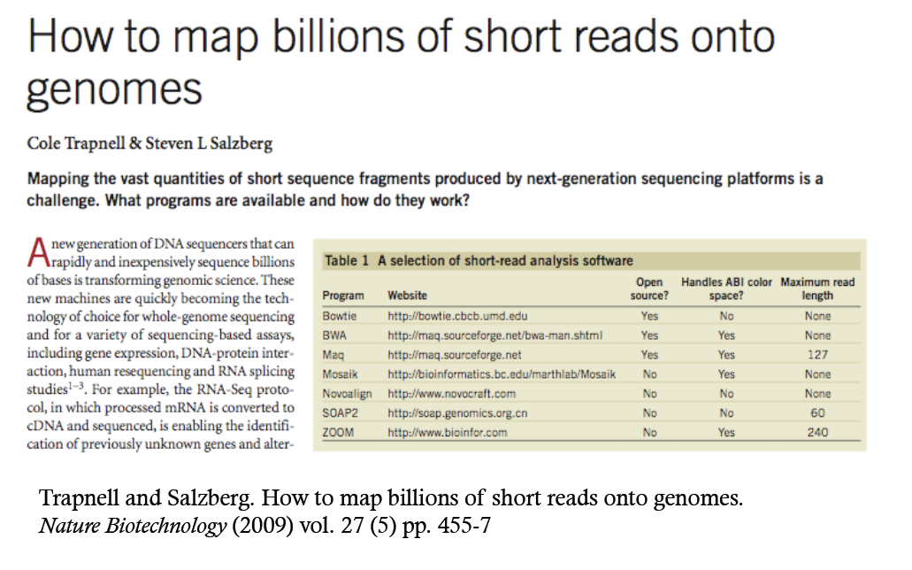

Slide 3
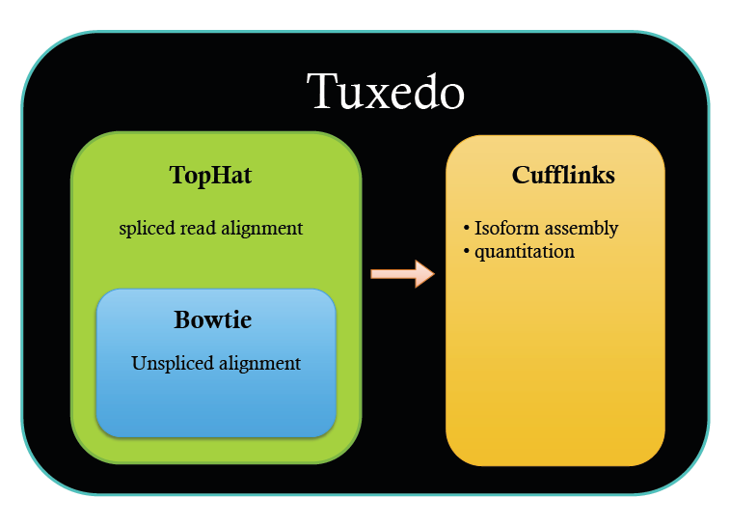


Slide 4
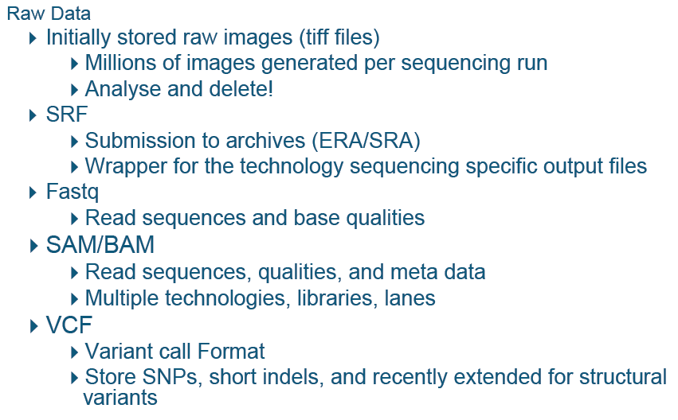
DATA

Slide 5
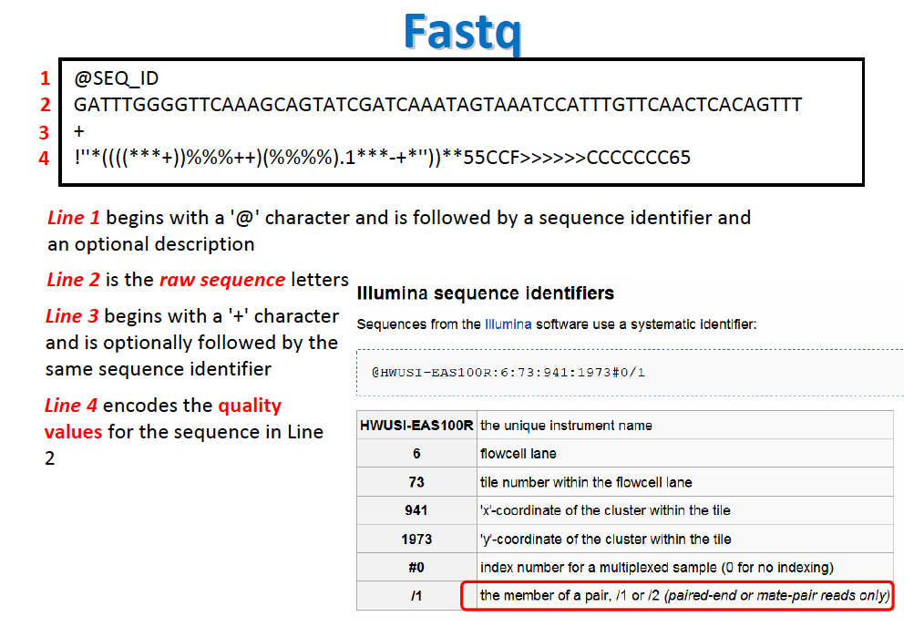
The Data: FASTQ

Slide 6
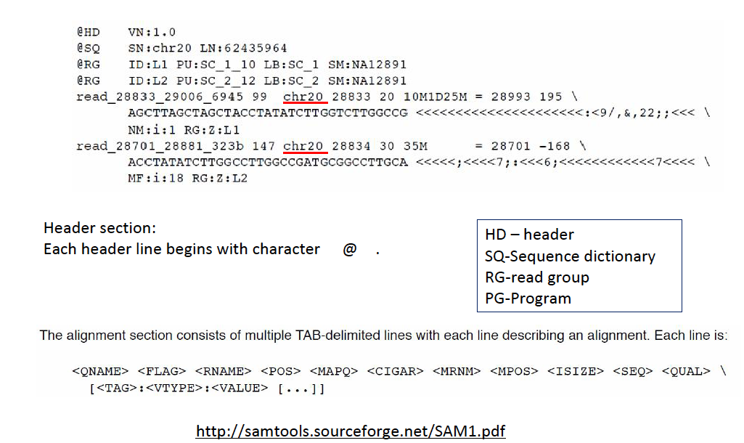
Data SAM

Slide 7
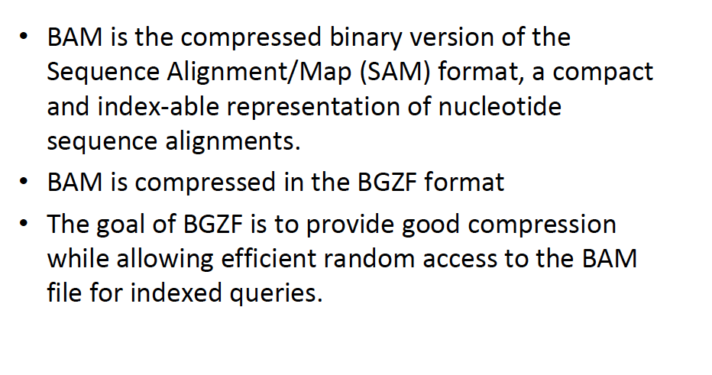
The Data: BAM

Slide 8
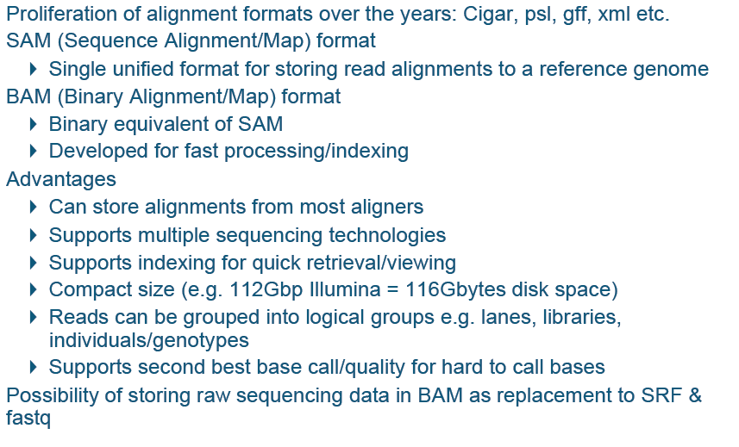
The Data: SAM/BAM

Slide 9
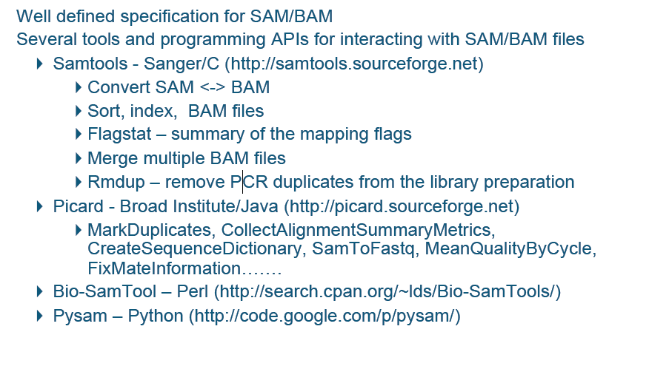
SAM/BAM Tools

Slide 10
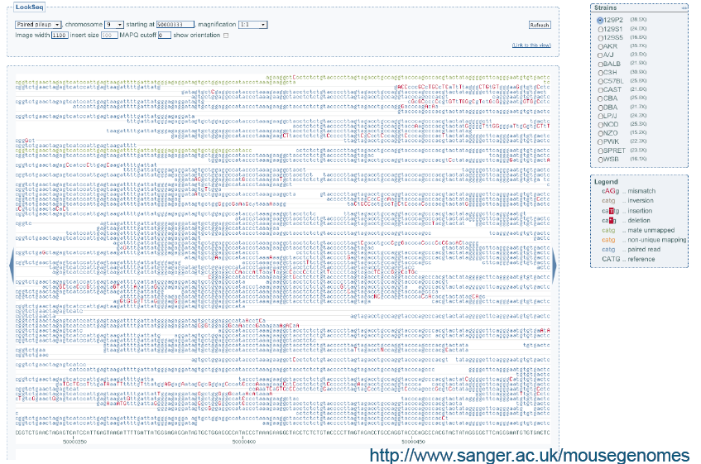
SAM/BAM: Visualization

Slide 11
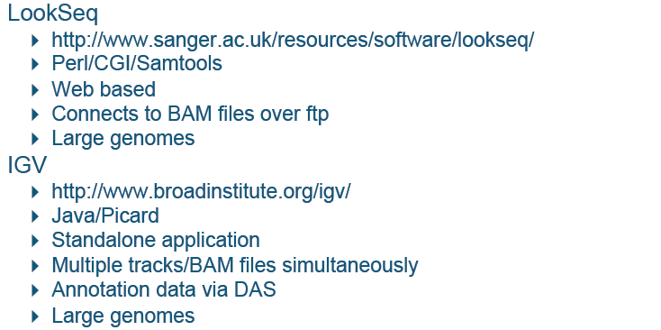
SAM/BAM: Visualization

Slide 12
SHORT READS

Slide 13
Short Read Applications
Goal: identify variations
Genotyping
RNA-seq, ChIP-seq, Methyl-seq
GGTATAC…
…CCATAG
TATGCGCCC
CGGAAATTT
CGGTATAC
…CCAT
CTATATGCG
TCGGAAATT
CGGTATAC
…CCAT
GGCTATATG
CTATCGGAAA
GCGGTATA
…CCA
AGGCTATAT
CCTATCGGA
TTGCGGTA
C…
…CCA
AGGCTATAT
GCCCTATCG
TTTGCGGT
C…
…CC
AGGCTATAT
GCCCTATCG
AAATTTGC
ATAC…
…CC
TAGGCTATA
GCGCCCTA
AAATTTGC
GTATAC…
…CCATAGGCTATATGCGCCCTATCGGCAATTTGCGGTATAC…
Goal: classify, measure significant peaks
GAAATTTGC
GGAAATTTG
CGGAAATTT
CGGAAATTT
TCGGAAATT
CTATCGGAAA
CCTATCGGA
TTTGCGGT
GCCCTATCG
AAATTTGC
…CC
GCCCTATCG
AAATTTGC
ATAC…
…CCATAGGCTATATGCGCCCTATCGGCAATTTGCGGTATAC…

Slide 14
Short Read Applications
GGTATAC…
…CCATAG
TATGCGCCC
CGGAAATTT
CGGTATAC
…CCAT
CTATATGCG
TCGGAAATT
CGGTATAC
…CCAT
GGCTATATG
CTATCGGAAA
GCGGTATA
…CCA
AGGCTATAT
CCTATCGGA
TTGCGGTA
C…
Finding the alignments is typically the performance bottleneck
…CCA
AGGCTATAT
GCCCTATCG
TTTGCGGT
C…
…CC
AGGCTATAT
GCCCTATCG
AAATTTGC
ATAC…
…CC
TAGGCTATA
GCGCCCTA
AAATTTGC
GTATAC…
…CCATAGGCTATATGCGCCCTATCGGCAATTTGCGGTATAC…
GAAATTTGC
GGAAATTTG
CGGAAATTT
CGGAAATTT
TCGGAAATT
CTATCGGAAA
CCTATCGGA
TTTGCGGT
GCCCTATCG
AAATTTGC
…CC
GCCCTATCG
AAATTTGC
ATAC…
…CCATAGGCTATATGCGCCCTATCGGCAATTTGCGGTATAC…

Slide 15
Short Read Alignment
Given a reference and a set of reads, report at least one “good” local alignment for each read if one exists
Approximate answer to: where in genome did read originate?
What is “good”? For now, we concentrate on:
Fewer mismatches is better
Failing to align a low-quality base is better than failing to align a high-quality base
…TGATCATA…
GATCAA
better than
…TGATCATA…
GAGAAT
…TGATATTA…
GATcaT
better than
…TGATcaTA…
GTACAT

Slide 16
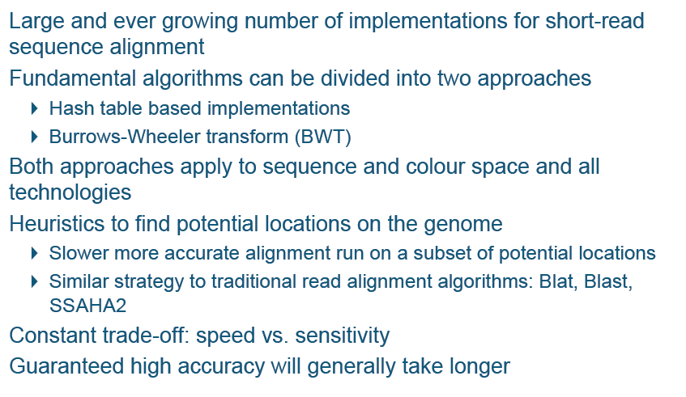
Short Read Alignment

Slide 17
Mapping Reads Using a Hash Table
MAQ, SOAP

Slide 18
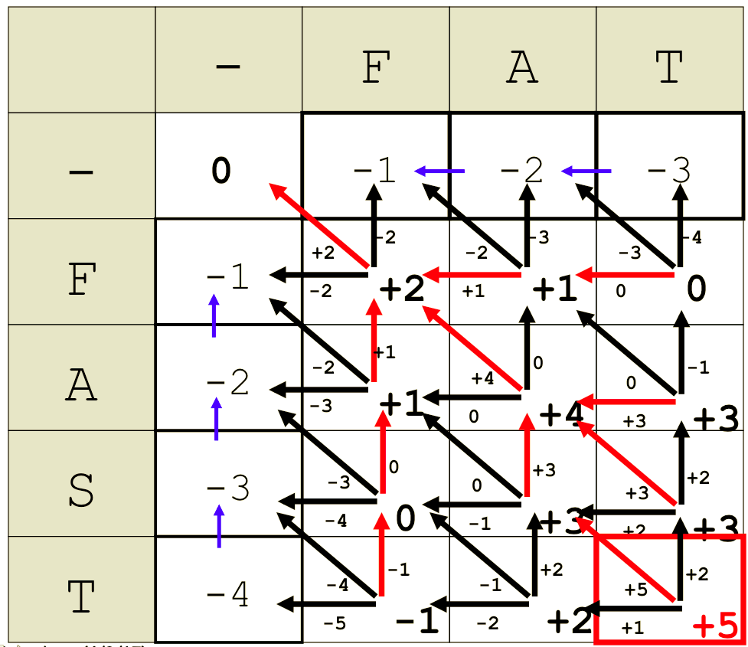
The Naïve Way
Dynamic programming

Slide 19
Mapping Methods: Indexing the Oligonucleotide Reads
ELAND (Cox, unpublished)
“Efficient Large-Scale Alignment of Nucleotide Databases” (Solexa Ltd.)
SeqMap (Jiang, 2008)
“Mapping massive amount of oligonucleotides to the genome”
RMAP (Smith, 2008)
“Using quality scores and longer reads improves accuracy of Solexa read mapping”
MAQ (Li, 2008)
“Mapping short DNA sequencing reads and calling variants using mapping quality scores”

Slide 20
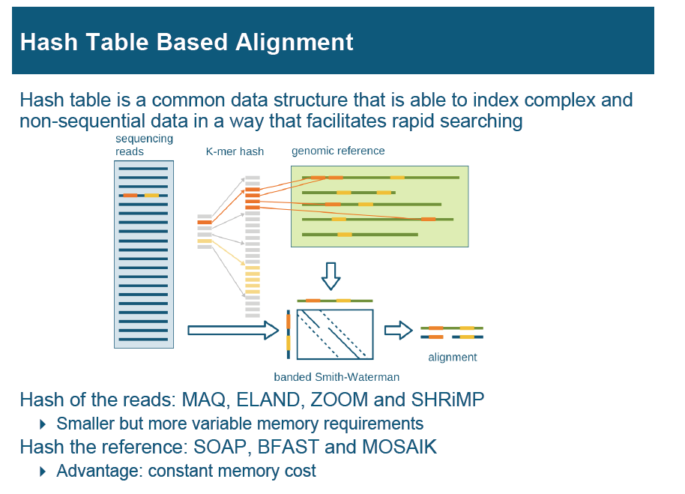

Slide 21
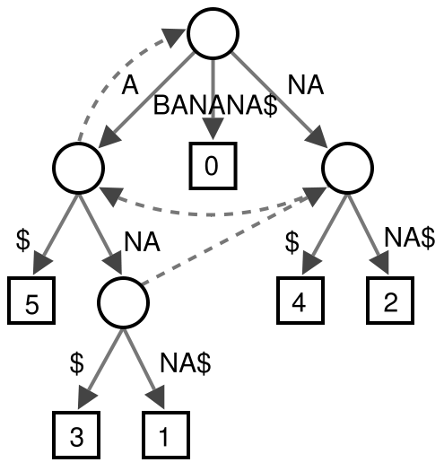
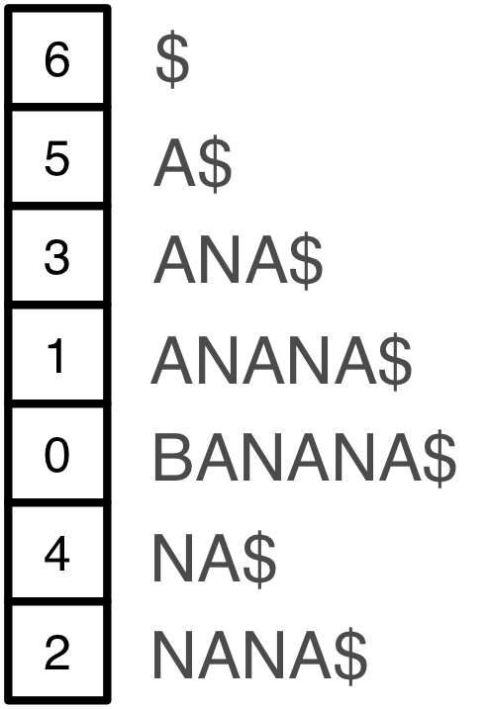
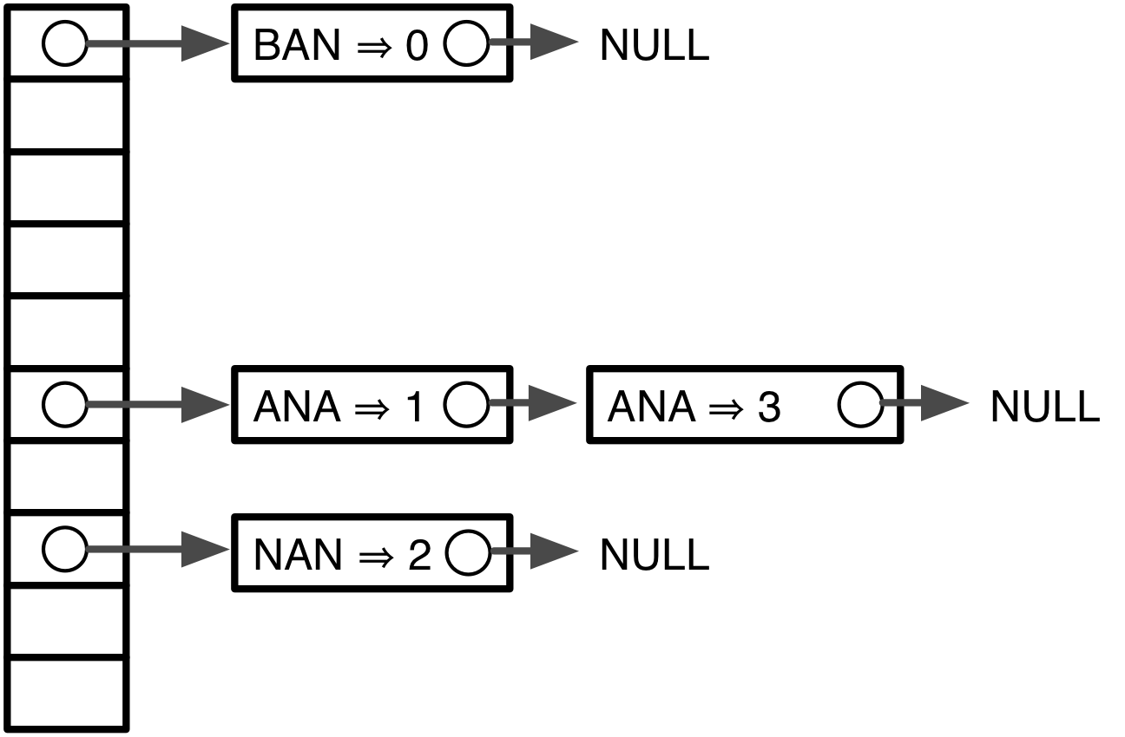
Indexing
Genomes and reads are too large for direct approaches like dynamic programming
Indexing is required
Choice of index is key to performance
Suffix tree
Suffix array
Seed hash tables
Many variants, incl. spaced seeds

Slide 22
Indexing
Genome indices can be big. For human:
Large indices necessitate painful compromises
Require big-memory machine
Use secondary storage
> 35 GBs
> 12 GBs
> 12 GBs
Build new index each run
Subindex and do multiple passes

Slide 23
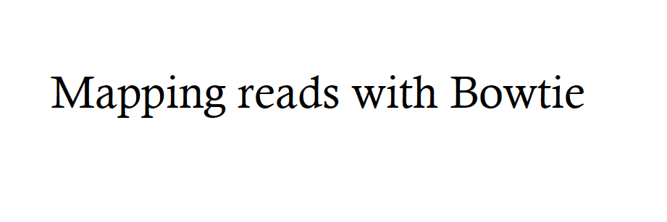

Slide 24
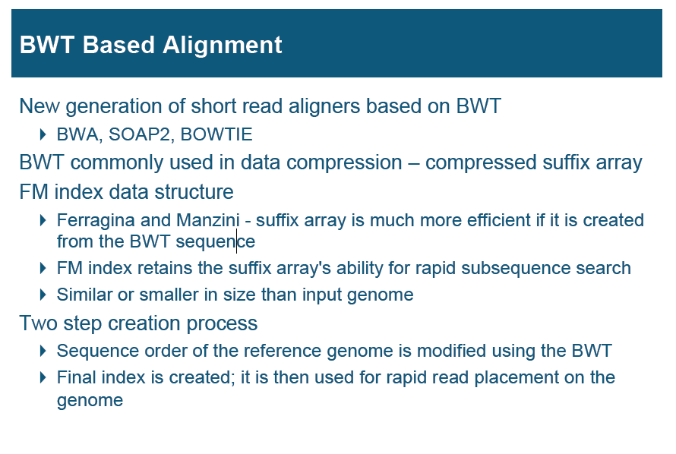

Slide 25
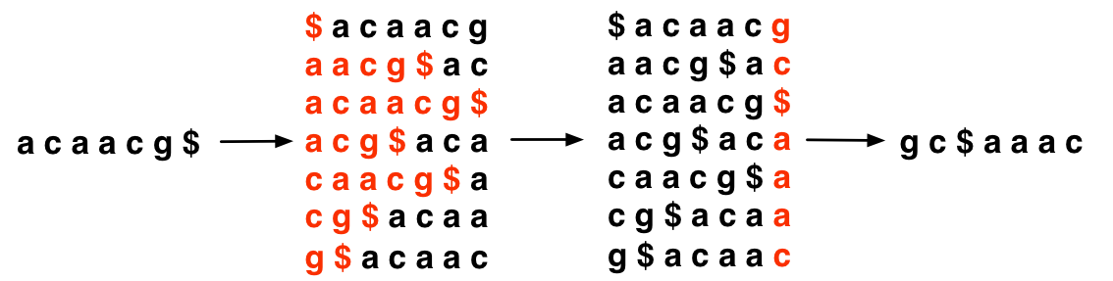
Burrows-Wheeler Transform
Reversible permutation used originally in compression
Once BWT(T) is built, all else shown here is discarded
Matrix will be shown for illustration only
T
BWT(T)
Burrows
Wheeler
Matrix
Last column
Burrows M, Wheeler DJ: A block sorting lossless data compression algorithm. Digital Equipment Corporation, Palo Alto, CA 1994, Technical Report 124; 1994

Slide 26
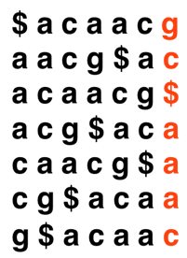

Burrows-Wheeler Transform
Property that makes BWT(T) reversible is “LF Mapping”
i^{th} occurrence of a character in Last column is same text occurrence as the i^{th} occurrence in First column
Rank: 2
BWT(T)
T
Rank: 2
Burrows Wheeler
Matrix

Slide 27
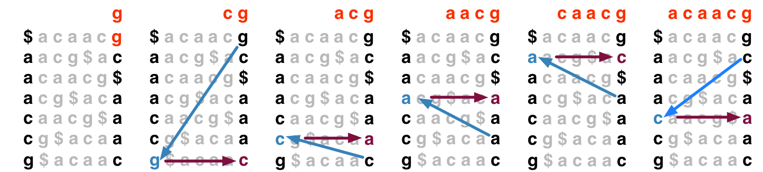
Burrows-Wheeler Transform
To recreate T from BWT(T), repeatedly apply rule:
T = BWT[ LF(i) ] + T; i = LF(i)
Where LF(i) maps row i to row whose first character corresponds to i’s last per LF Mapping
Could be called “unpermute” or “walk-left” algorithm
Final T

Slide 28
FM Index
Ferragina & Manzini propose “FM Index” based on BWT
Observed:
LF Mapping also allows exact matching within T
LF(i) can be made fast with checkpointing
…and more (see FOCS paper)
Ferragina P, Manzini G: Opportunistic data structures with applications. FOCS. IEEE Computer Society; 2000.
Ferragina P, Manzini G: An experimental study of an opportunistic index. SIAM symposium on Discrete algorithms. Washington, D.C.; 2001.

Slide 29
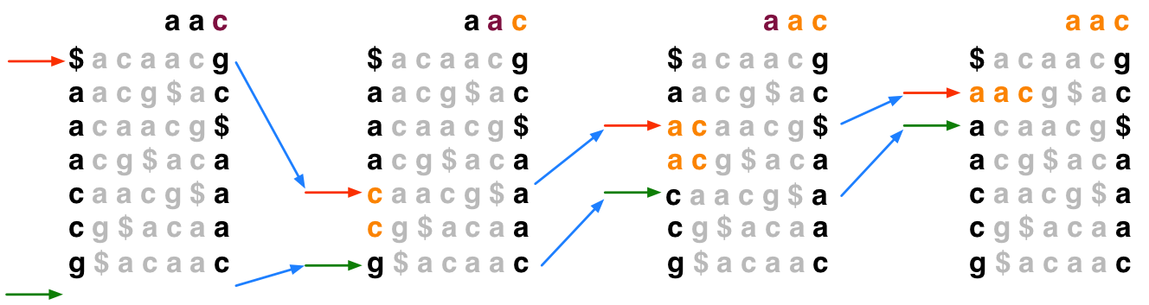
Exact Matching with FM Index
To match Q in T using BWT(T), repeatedly apply rule:
top = LF(top, qc); bot = LF(bot, qc)
Where qc is the next character in Q (right-to-left) and LF(i, qc) maps row i to the row whose first character corresponds to i’s last character as if it were qc

Slide 30
Exact Matching with FM Index
In progressive rounds, top & bot delimit the range of rows beginning with progressively longer suffixes of Q

Slide 31
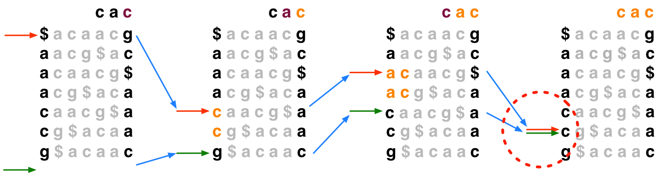
Exact Matching with FM Index
If range becomes empty (top = bot) the query suffix (and therefore the query) does not occur in the text

Slide 32
Rows to Reference Positions
Once we know a row contains a legal alignment, how do we determine its position in the reference?
Where am I?

Slide 33
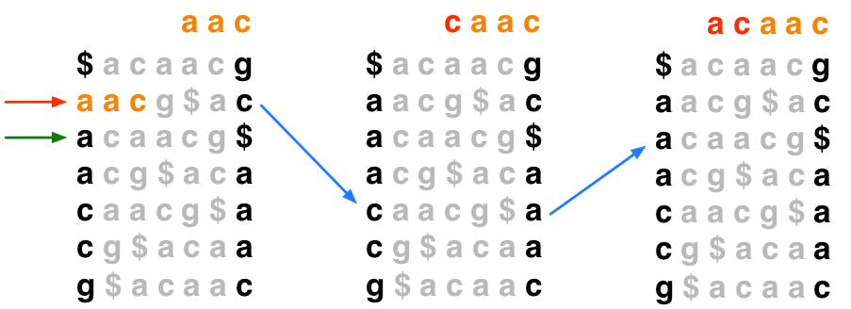
Rows to Reference Positions
Naïve solution 1: Use “walk-left” to walk back to the beginning of the text; number of steps = offset of hit
Linear in length of text in general – too slow
2 steps, so hit offset = 2

Slide 34
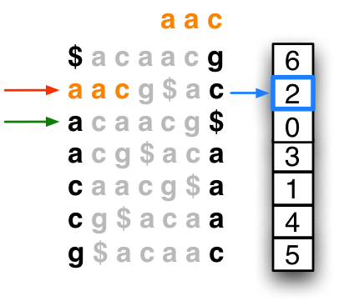
Rows to Reference Positions
Naïve solution 2: Keep whole suffix array in memory. Finding reference position is a lookup in the array.
Suffix array is ~12 gigabytes for human – too big
hit offset = 2

Slide 35
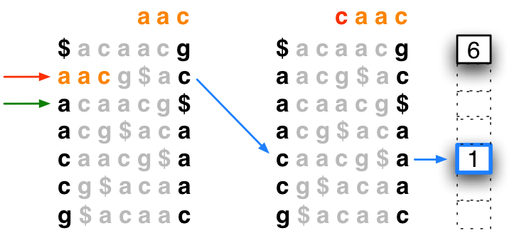
Rows to Reference Positions
Hybrid solution: Store sample of suffix array; “walk left” to next sampled (“marked”) row to the left
Due to Ferragina and Manzini
Bowtie marks every 32nd row by default (configurable)
1 step
offset = 1
Hit offset = 1 + 1 = 2

Slide 36
Put It All Together
Algorithm concludes: “aac” occurs at offset 2 in “acaacg”

Slide 37

Checkpointing in FM Index
LF(i, qc) must determine the rank of qc in row i
Naïve way: count occurrences of qc in all previous rows
This LF(i, qc) is linear in length of text – too slow
Scanned by naïve rank calculation

Slide 38
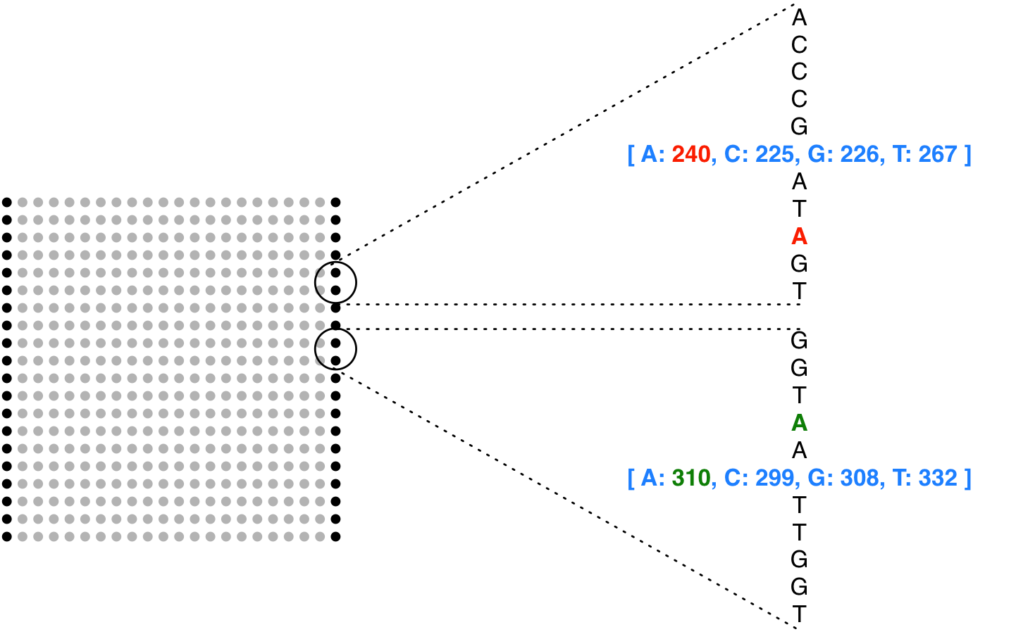
Checkpointing in FM Index
Solution: pre-calculate cumulative counts for A/C/G/T up to periodic checkpoints in BWT
LF(i, qc) is now constant-time
(if space between checkpoints is considered constant)
Rank: 242
Rank: 309

Slide 39
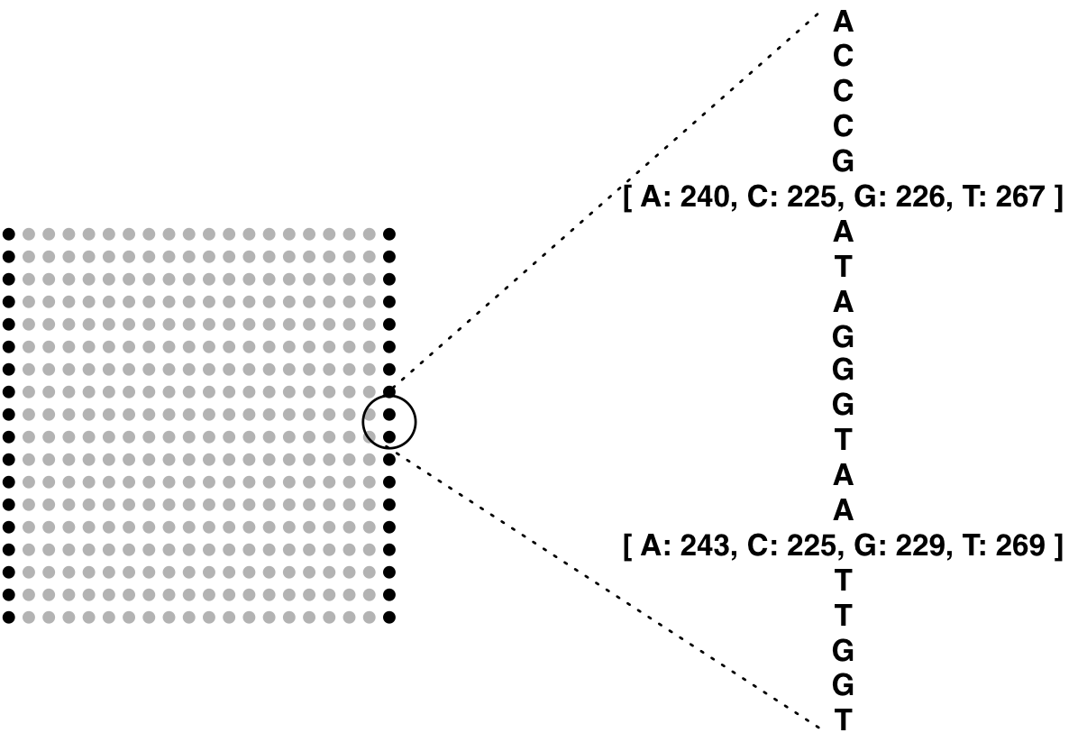
FM Index is Small
Entire FM Index on DNA reference consists of:
BWT (same size as T)
Checkpoints (~15% size of T)
SA sample (~50% size of T)
Total: ~1.65x the size of T
Assuming 2-bit-per-base encoding and
no compression, as in Bowtie
Assuming a 16-byte checkpoint every 448 characters, as in Bowtie
Assuming Bowtie defaults for suffix-array sampling rate, etc
~1.65x
>45x
>15x
>15x

Slide 40
FM Index in Bioinformatics
Oligomer counting
Healy J et al: Annotating large genomes with exact word matches. Genome Res 2003, 13(10):2306-2315.
Whole-genome alignment
Lippert RA: Space-efficient whole genome comparisons with Burrows-Wheeler transforms. J Comp Bio 2005, 12(4):407-415.
Smith-Waterman alignment to large reference
Lam TW et al: Compressed indexing and local alignment of DNA. Bioinformatics 2008, 24(6):791-797.

Slide 41
Short Read Alignment
FM Index finds exact sequence matches quickly in small memory, but short read alignment demands more:
Allowances for mismatches
Consideration of quality values
Lam et al try index-assisted Smith-Waterman
Slower than BLAST
Bowtie’s solution: backtracking quality-aware search

Slide 42
Backtracking
Consider an attempt to find Q = “agc” in T = “acaacg”:
Instead of giving up, try to “backtrack” to a previous position and try a different base
“g”
“c”
“gc” does not occur in the text

Slide 43
Backtracking
Backtracking attempt for Q = “agc”, T = “acaacg”:
“g”
“c”
“gc” does not occur in the text
Substitution
“a”
“a”
Found this alignment:
acaacg
agc
“c”

Slide 44
Backtracking
May not be so lucky
“g”
“t”
“c”
“a”
“a”
Found this alignment (eventually):
acaacg
agc

Slide 45
Backtracking
Relevant alignments may lie along multiple paths
E.g., Q = “aaa”, T = “acaacg”
“a”
“a”
“a”
“a”
“a”
“c”
“a”
“a”
“c”
“a”
“a”
“c”
acaacg
acaacg
acaacg
aaa
aaa
aaa

Slide 46
Backtracking
Bowtie’s –v <int> option allows alignments with up to <int> mismatches
Regardless of quality values
Max mismatches allowed: 3
Equivalent to SOAP’s* –v option
* Li R et al: SOAP: short oligonucleotide alignment program. Bioinformatics 2008, 24(5):713-714.

Slide 47
Qualities
When backtracking is necessary, Bowtie will backtrack to leftmost just-visited position with minimal quality
Greedy, depth-first, not optimal, but simple
Sequence:
G
C
C
A
T
A
C
G
G
A
T
T
A
G
C
C
Phred Quals:
40
40
35
40
40
40
40
30
30
20
15
15
40
40
40
40
(higher number = higher confidence)
G
C
C
A
T
A
C
G
G
A
C
T
A
G
C
C
40
40
35
40
40
40
40
30
30
20
15
15
40
40
40
40
G
C
C
A
T
A
C
G
G
G
C
T
A
G
C
C
40
40
35
40
40
40
40
30
30
20
15
15
40
40
40
40

Slide 48
Qualities
Bowtie supports a Maq*-like alignment policy
≤ N mismatches allowed in first L bases on left end
Sum of mismatch qualities may not exceed E
N, L and E configured with -n, -l, -e
E.g.:
Maq-like is Bowtie’s default mode (N=2, L=28, E=70)
G
C
C
A
T
A
C
G
G
G
C
T
A
G
C
C
If N < 2
40
40
35
40
40
40
40
30
30
20
15
15
40
25
5
5
If E < 45
If L < 9 and N < 2
L=12
E=50, N=2
* Li H, Ruan J, Durbin R: Mapping short DNA sequencing reads and calling variants using mapping quality scores. Genome Res 2008.

Slide 49
Implementation
Free, Open Source under Artistic License
C++
Uses SeqAn* library (http://www.seqan.de)
Uses POSIX threads to exploit parallelism
bowtie-build is the indexer
bowtie is the aligner
bowtie-convert converts Bowtie’s alignment output format to Maq’s .map format
Users may leverage tools in the Maq suite, e.g., maq assemble, maq cns2snp
Uses code from Maq
* Doring A, Weese D, Rausch T, Reinert K: SeqAn an efficient, generic C++ library for sequence analysis. BMC Bioinformatics 2008, 9:11.

Slide 50
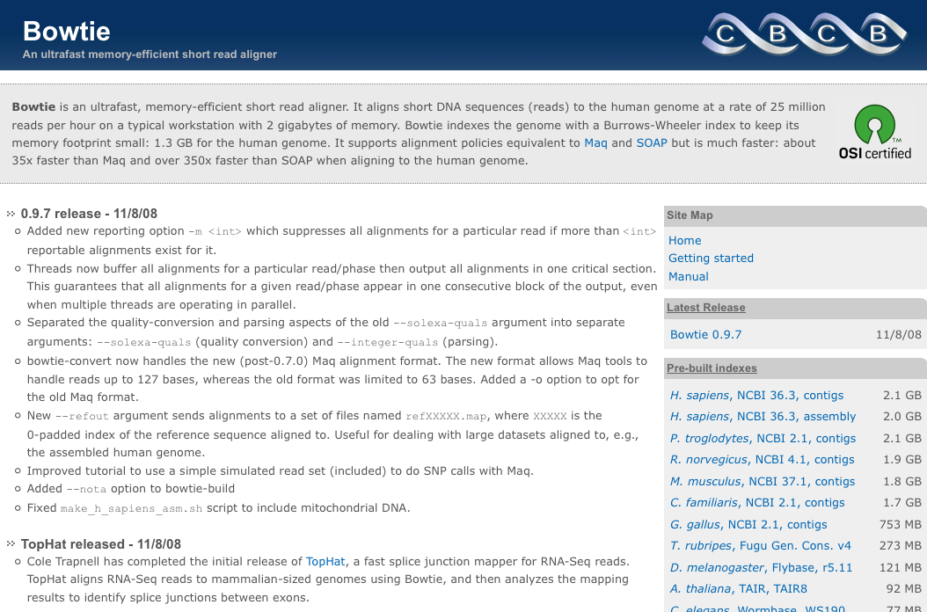
http://bowtie-bio.sf.net

Slide 51
Indexing Performance
Bowtie employs a indexing algorithm* that can trade flexibly between memory usage and running time
For human (NCBI 36.3) on 2.4 GHz AMD Opteron:
Physical memory Target | Actual peak memory footprint | Wall clock time
16 GB | 14.4 GB | 4h:36m
8 GB | 5.84 GB | 5h:05m
4 GB | 3.39 GB | 7h:40m
2 GB | 1.39 GB | 21h:30m
* Kärkkäinen J: Fast BWT in small space by blockwise suffix sorting. Theor Comput Sci 2007, 387(3):249-257.

Slide 52
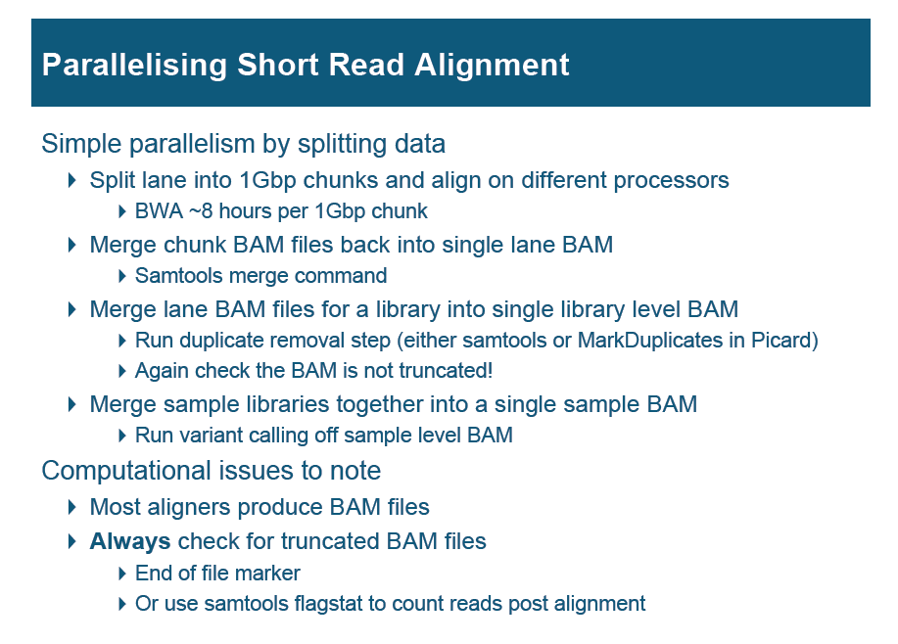

Slide 53

1000 Genomes Genotyping
…CCATAG
TATGCGCCC
CGGAAATTT
CGGTATAC
…CCAT
CTATATGCG
TCGGAAATT
CGGTATAC
…CCAT
GGCTATATG
CTATCGGAAA
GCGGTATA
…CCA
AGGCTATAT
CCTATCGGA
TTGCGGTA
C…
…CCA
AGGCTATAT
GCCCTATCG
TTTGCGGT
C…
…CC
AGGCTATAT
GCCCTATCG
AAATTTGC
ATAC…
…CC
TAGGCTATA
GCGCCCTA
AAATTTGC
GTATAC…
…CCATAGGCTATATGCGCCCTATCGGCAATTTGCGGTATAC…
Bowtie aligns all 1000-Genomes (Build 2) reads for human subject NA12892 on a 2.4 Ghz Core 2 workstation with 4 GB of RAM with 4 parallel threads:
14.3x coverage, 935 M reads, 42.9 Gbases
Running time: 14 hrs – 1 overnight

Slide 54
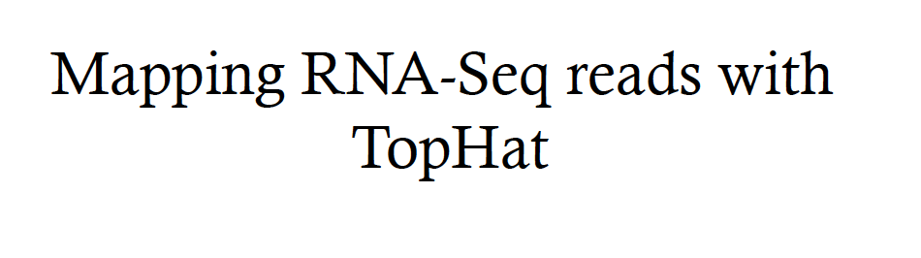

Slide 55
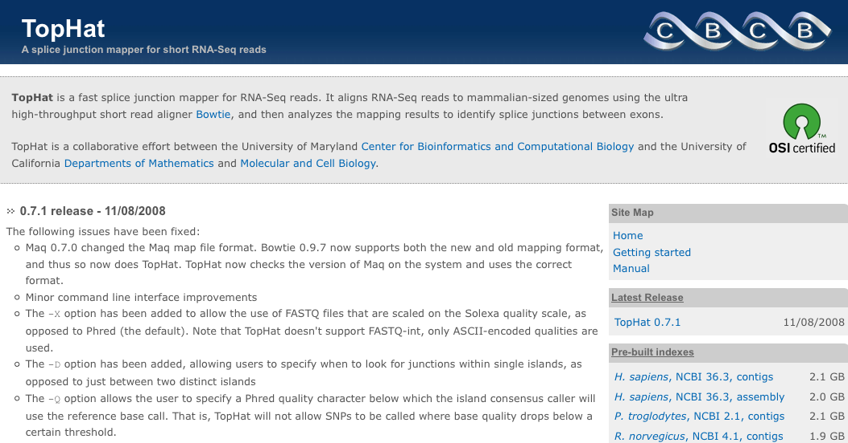
TopHat: Bowtie for RNA-seq
TopHat is a fast splice junction mapper for RNA-Seq reads. It aligns RNA-Seq reads using Bowtie, and then analyzes the mapping results to identify splice junctions between exons.
Contact: Cole Trapnell (cole@cs.umd.edu)
http://tophat.cbcb.umd.edu

Slide 56
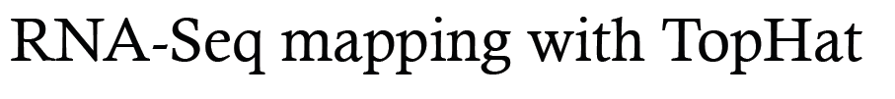
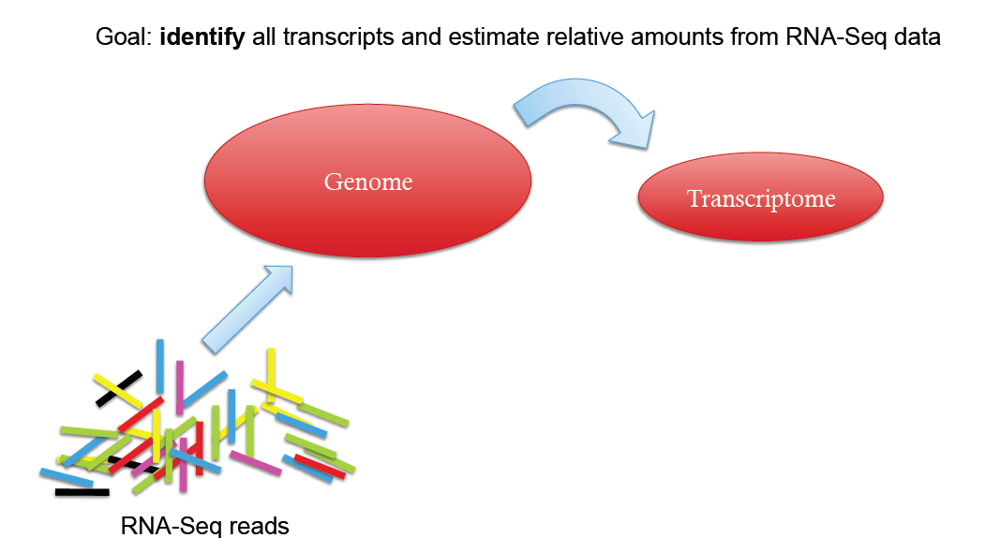

Slide 57
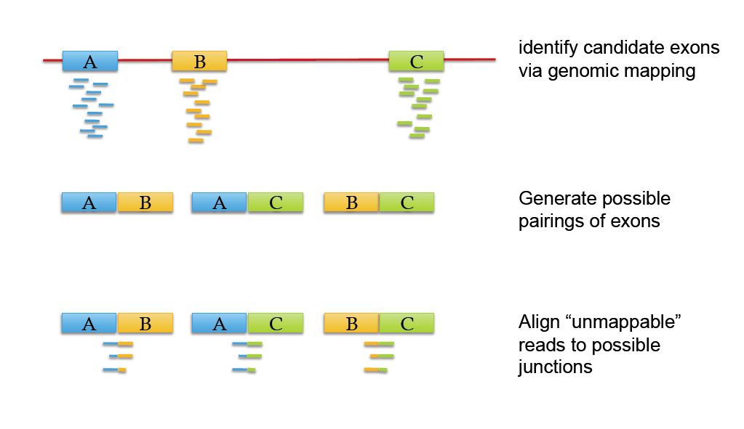

Slide 58
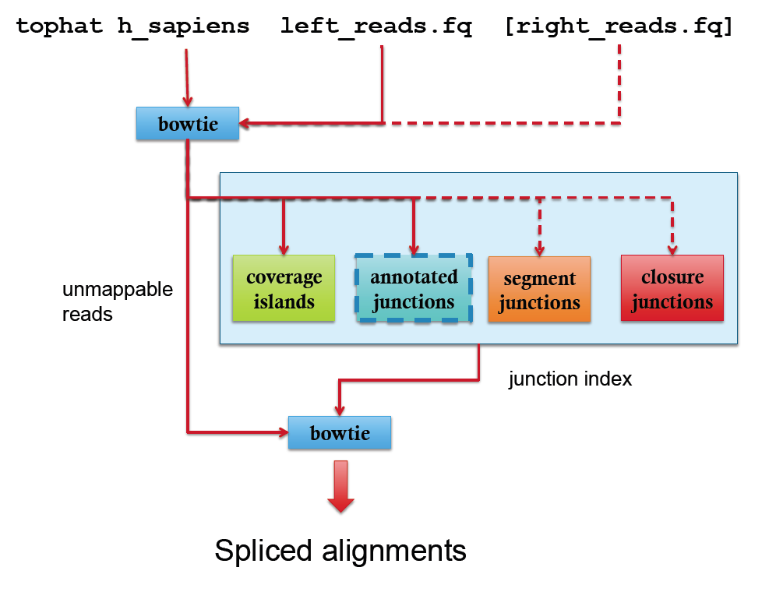

Slide 59
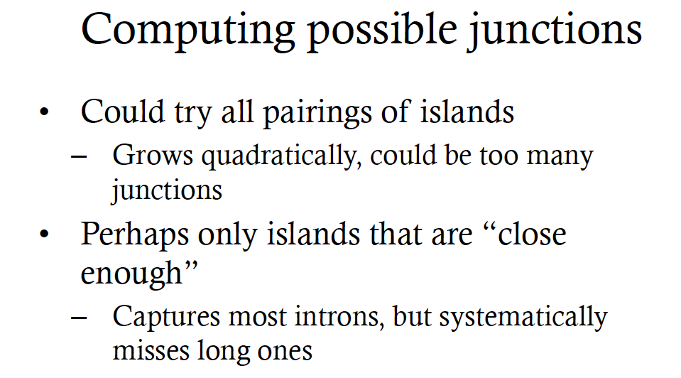

Slide 60
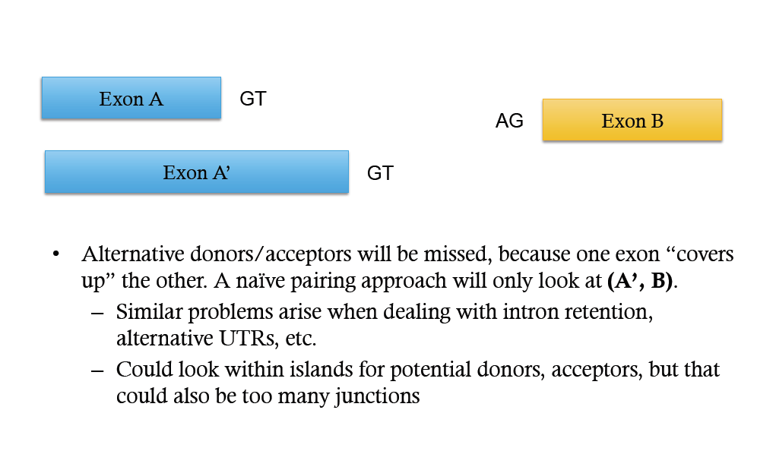

Slide 61
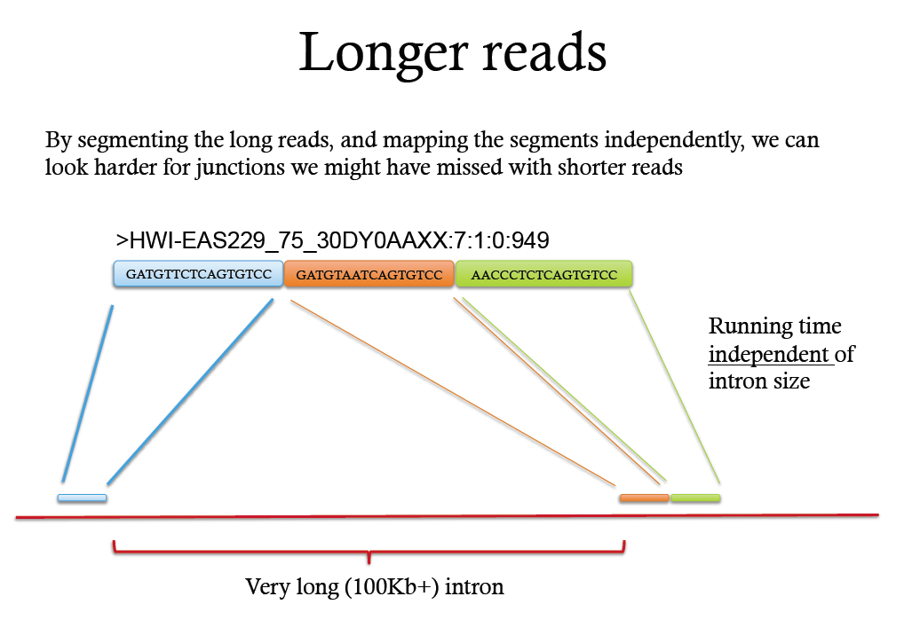

Slide 62
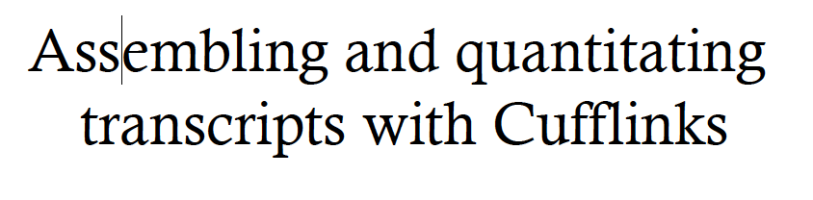

Slide 63
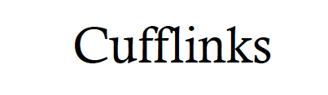
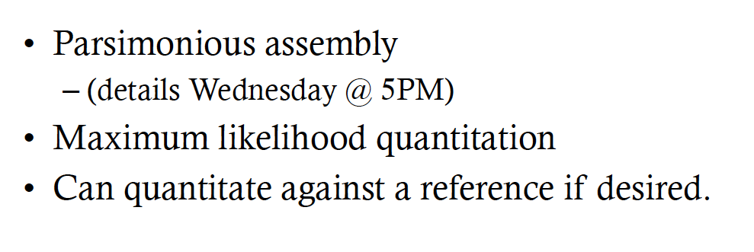

Slide 64
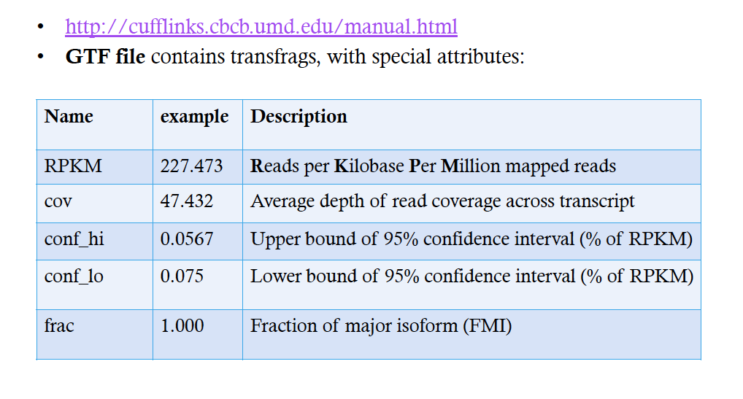

Slide 65
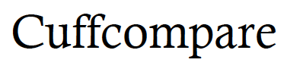
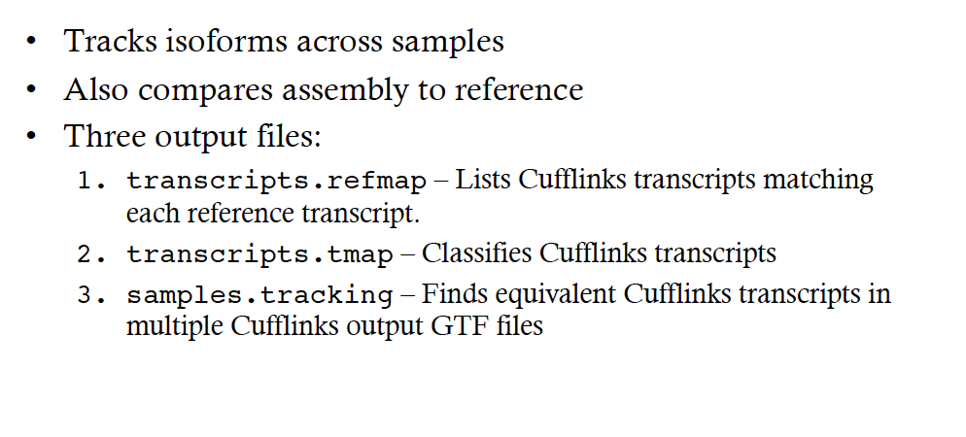

Slide 66
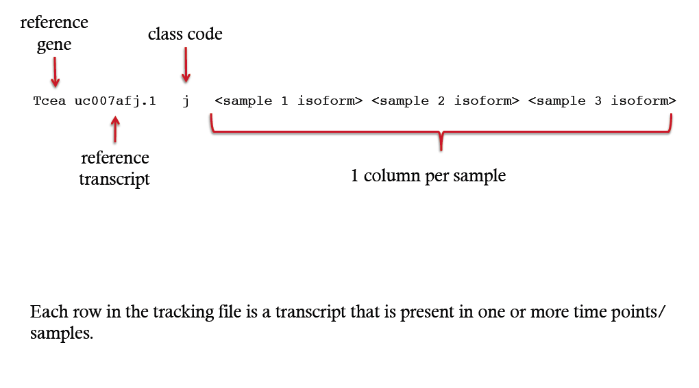

Slide 67
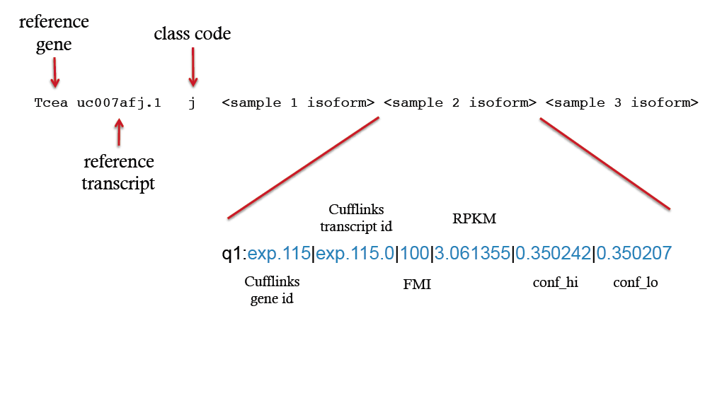

Slide 68
RNA seq analysis pipeline
Diginorm
Trinity normalization
Trinity, SOAP-denovo
Perform statistical analysis to identify differential expression (or differential splicing) among samples or treatments
QC, Demultiplex, filter, and trim sequencing reads
Normalize sequencing reads
de novo assembly of transcripts or
Tophat, HISAT, STAR
Map (align) sequencing reads to reference genome or transcriptome
Cufflinks
Annotate transcripts assembled and count mapped reads to estimate transcript abundance
Cuffdiff, eXpress,DESeq2
FASTQC, Trimmomatic
Notes:
Normalization-Several factors preclude raw read counts across different libraries, Some samples are sequenced at higher depth than others
RPKM = reads per kilobase per million mapped reads (FOR SINGLE END RNA SEQ)
​ FPKM: Fragment per kilobases per million mapped reads (FOR PAIRED END RNA SEQ)

Slide 69
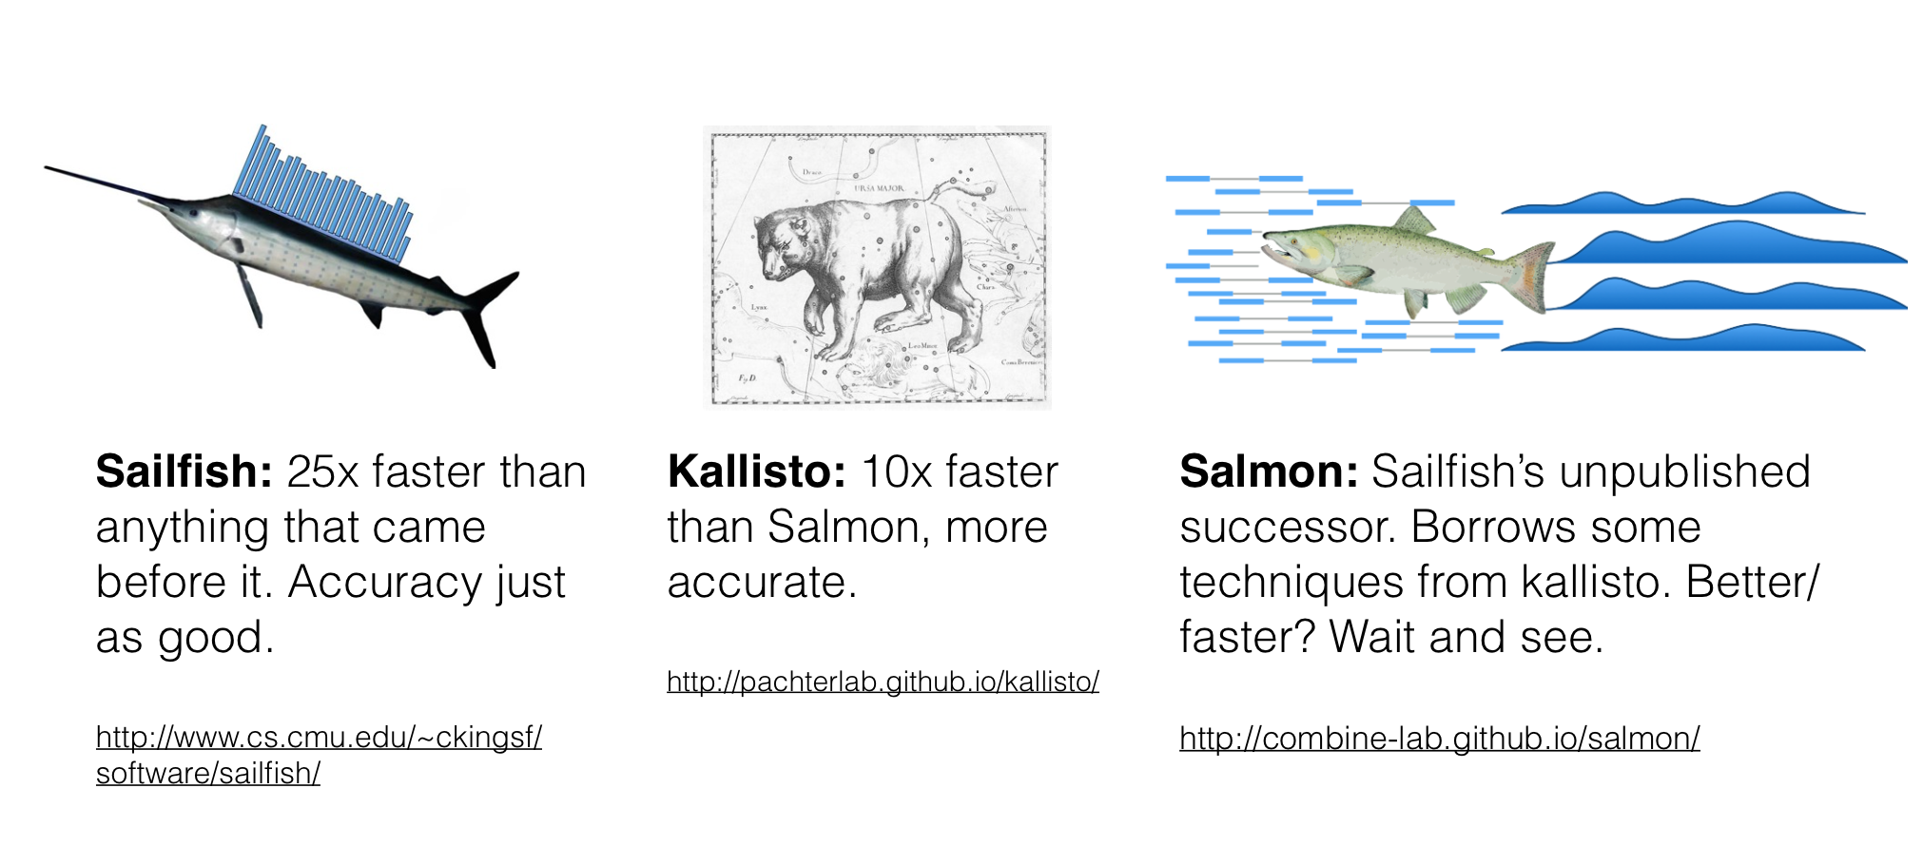
“Alignment free” quantification

Slide 70
Kallisto
Introduction of pseudoalignment instead of alignment
-Nicolas Bray, Ph.D. thesis 2014.
RNA-Seq analysis of 30 million reads in 2.5 minutes; 500—1000x faster than previous approaches. Possible thanks to fast hashing techniques and pseudoalignment via the Target de Bruijn Graph.
First ever RNA-Seq analysis approach that is tractable on a laptop while being as accurate (or more accurate) than existing methods.
Speed allows for bootstrapping to obtain uncertainty estimates, thus leading to new methods for differential analysis.

Slide 71
RNA-Seq transcript abundance
Given a set of RNA-seq reads and a reference transcriptome , quantify proportion of each transcript
RNA-seq reads: assume standard reads, single or paired end reads
Reference transcriptome: does not require a genome reference, works only with transcriptome
Proportion: corresponds to TPM(transcripts per million) “for every 1M transcripts expressed how many are in this one?”
Notes:
TPM- if took a 1 million transcripts and if I am looking at this specific transcripts how many would I see. This is a scaled propbality distribution

Slide 72
Why Kallisto?
Advantages:
Pseudoalignment of reads preserves the key information needed for quantification.
Blazing fast and accurate
Notes:
Two conditions, it coould be some control and a treatement., and kallisto, alginemnet without or with annotation , without means you are typically aligneing to genome and there are number of ways to qauntify. is therefore not only fast, but also as accurate than existing quantification tools

Slide 73
Pseudoalignment
Given a paired read, from which transcript could I have originated from?
Not nucleotide sequence alignment
It determines, for each read, not where in each transcript it aligns, but rather which transcripts it is compatible with.
Pseudoalignments provide the sufficient statistic for the EM algorithm
How fast is Pseudoalignment?
The quantification of 78.6 million reads takes 14 minutes on a standard desktop using a single CPU core.
~6 million reads quantified per minute
Notes:
Pseudo – given a read, list of trancripts it could have come from

Slide 74
Why Kallisto?
Most RNA seq tools(Cufflinks, RSEM, eXpress etc) do RNA seq analysis in two parts-
Alignment- Align reads to transcriptome or split reads over genome
Quantification- converts the alignments to abundance metrics( FPKM, RPKM, TPM)
Two clusters of quantification tools, count based Vs. Expectation-Maximization(EM) based
Key difference is how they deals with ambiguous read alignments
Kallisto fuses the two steps
Reads are pseudoaligned to the reference transcriptome
EM algorithm deconvolutes pseudoalignments to obtain transcript abundances
Notes:
Count based: How many genes are assigned to each gene, EM: look this at transcript level and takes into account normailzation different lengths of transcripts .
Things that are non-ambig when u map to gene model become ambinoug when reads are shared betwn two transcripts

Slide 75
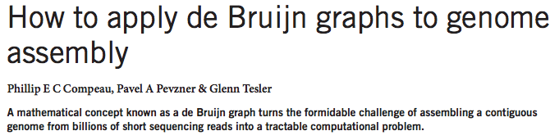
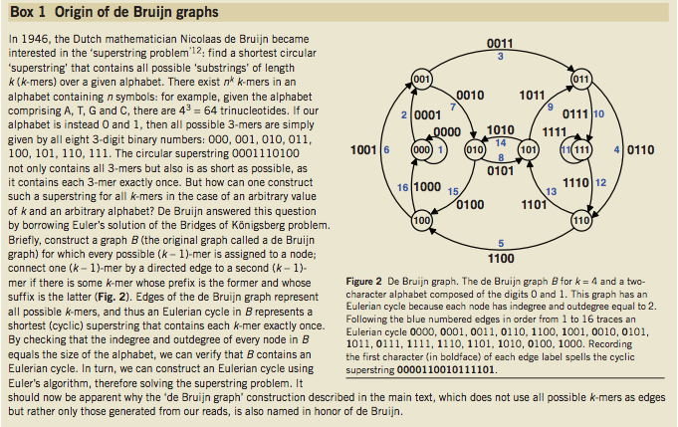


Slide 76


Target de Bruijn Graph (T-DBG)
http://arxiv.org/pdf/1505.02710v2.pdf
Create every k-mer in the transcriptome (k=31), build de Bruin Graph and color each k-mer
Preprocess the transcriptome to create the T-DBG
Indexing is faster
Notes:
This is the data structure that givrs advantage to akllisto its called the T-DBG. You build a kmer of every single transcript and walk along this path, wherever they differ you create a new path

Slide 77
Target de Bruijn Graph (T-DBG)
http://arxiv.org/pdf/1505.02710v2.pdf
Use k-mers in read to find which transcript it came from
Want to find pseudo alignments
pseudoalignment : which transcripts the read (pair) is compatible with not an alignment of the nucleotide sequences.
Notes:
Whe you get a read you match the Kmers along the graph, you notice all the paths are colored, colors basically tell use what transcripts this match is compatable with

Slide 78
Target de Bruijn Graph (T-DBG)
http://arxiv.org/pdf/1505.02710v2.pdf
Each k-mer appears in a set of transcripts
The intersection of all sets is our pseudoalignment
Can jump over k-mers in the T-DBG that provide same information Jumping provides ~8x speedup over chekcing all k-mers

Slide 79
Performance - Accuracy
Simulated 20, 30M PE reads using RSEM simulator
Relative difference =
Accuracy
http://arxiv.org/pdf/1505.02710v2.pdf
Notes:
Relative diffrence metric, the simulatro set is supposed to be aplpha true we estimated it to be alpha est and we compute the realtive diffrence

Slide 80
Performance - speed
Total running time for running 20 samples on 20 cores.
Speed
http://arxiv.org/pdf/1505.02710v2.pdf

Slide 81

Bootstrap
A new statistical feature of Kallisto, possible only because of its speed, is the bootstrap
The result is that we can accurately estimate the uncertainty in abundance estimates
http://arxiv.org/pdf/1505.02710v2.pdf
Notes:
The result is that we can accurately estimate the uncertainty in abundance estimates. It is based on an analysis of 40 samples of 30 million reads subsampled from 275 million rat RNA-Seq reads. Each dot corresponds to a transcript and is colored by its abundance. The x-axis shows the variance estimated from kallisto bootstraps on a single subsample while the y-axis shows the variance computed from the different subsamples of the data. We see that the bootstrap recapitulates the empirical variance.

Slide 82
Other Issues
Paired-end alignment
Finding alignments with insertions and deletions
ABI color-space support

Slide 84

The Data: CSFASTQ (ABI)

Slide 85
Comparison to Maq & SOAP
 | CPU time | Wall clock time | Reads per hour | Peak virtual memory footprint | Bowtie speedup | Reads aligned (%)
Bowtie –v 2 (server) | 15m:07s | 15m:41s | 33.8 M | 1,149 MB | - | 67.4
SOAP (server) | 91h:57m:35s | 91h:47m:46s | 0.08 M | 13,619 MB | 351x | 67.3
Bowtie (PC) | 16m:41s | 17m:57s | 29.5 M | 1,353 MB | - | 71.9
Maq (PC) | 17h:46m:35s | 17h:53m:07s | 0.49 M | 804 MB | 59.8x | 74.7
Bowtie (server) | 17m:58s | 18m:26s | 28.8 M | 1,353 MB | - | 71.9
Maq (server) | 32h:56m:53s | 32h:58m:39s | 0.27 M | 804 MB | 107x | 74.7
PC: 2.4 GHz Intel Core 2, 2 GB RAM
Server: 2.4 GHz AMD Opteron, 32 GB RAM
Bowtie v0.9.6, Maq v0.6.6, SOAP v1.10
SOAP not run on PC due to memory constraints
Reads: FASTQ 8.84 M reads from 1000 Genomes (Acc: SRR001115)
Reference: Human (NCBI 36.3, contigs)

Slide 86
Comparison to Maq & SOAP
 | CPU time | Wall clock time | Reads per hour | Peak virtual memory footprint | Bowtie speedup | Reads aligned (%)
Bowtie –v 2 (server) | 15m:07s | 15m:41s | 33.8 M | 1,149 MB | - | 67.4
SOAP (server) | 91h:57m:35s | 91h:47m:46s | 0.08 M | 13,619 MB | 351x | 67.3
Bowtie (PC) | 16m:41s | 17m:57s | 29.5 M | 1,353 MB | - | 71.9
Maq (PC) | 17h:46m:35s | 17h:53m:07s | 0.49 M | 804 MB | 59.8x | 74.7
Bowtie (server) | 17m:58s | 18m:26s | 28.8 M | 1,353 MB | - | 71.9
Maq (server) | 32h:56m:53s | 32h:58m:39s | 0.27 M | 804 MB | 107x | 74.7
Bowtie delivers about 30 million alignments per CPU hour

Slide 87
Comparison to Maq & SOAP
 | CPU time | Wall clock time | Reads per hour | Peak virtual memory footprint | Bowtie speedup | Reads aligned (%)
Bowtie –v 2 (server) | 15m:07s | 15m:41s | 33.8 M | 1,149 MB | - | 67.4
SOAP (server) | 91h:57m:35s | 91h:47m:46s | 0.08 M | 13,619 MB | 351x | 67.3
Bowtie (PC) | 16m:41s | 17m:57s | 29.5 M | 1,353 MB | - | 71.9
Maq (PC) | 17h:46m:35s | 17h:53m:07s | 0.49 M | 804 MB | 59.8x | 74.7
Bowtie (server) | 17m:58s | 18m:26s | 28.8 M | 1,353 MB | - | 71.9
Maq (server) | 32h:56m:53s | 32h:58m:39s | 0.27 M | 804 MB | 107x | 74.7
Disparity in reads aligned between Bowtie (67.4%) and SOAP (67.3%) is slight

Slide 88
Comparison to Maq & SOAP
 | CPU time | Wall clock time | Reads per hour | Peak virtual memory footprint | Bowtie speedup | Reads aligned (%)
Bowtie –v 2 (server) | 15m:07s | 15m:41s | 33.8 M | 1,149 MB | - | 67.4
SOAP (server) | 91h:57m:35s | 91h:47m:46s | 0.08 M | 13,619 MB | 351x | 67.3
Bowtie (PC) | 16m:41s | 17m:57s | 29.5 M | 1,353 MB | - | 71.9
Maq (PC) | 17h:46m:35s | 17h:53m:07s | 0.49 M | 804 MB | 59.8x | 74.7
Bowtie (server) | 17m:58s | 18m:26s | 28.8 M | 1,353 MB | - | 71.9
Maq (server) | 32h:56m:53s | 32h:58m:39s | 0.27 M | 804 MB | 107x | 74.7
Disparity in reads aligned between Bowtie (71.9%) and Maq (74.7%) is more substantial (2.8%)
Mostly because Maq –n 2 reports some, but not all, alignments with 3 mismatches in first 28 bases
Fraction (<5%) of disparity is due to Bowtie’s backtracking limit (a heuristic not discussed here)

Slide 89
Comparison to Maq & SOAP
 | CPU time | Wall clock time | Reads per hour | Peak virtual memory footprint | Bowtie speedup | Reads aligned (%)
Bowtie –v 2 (server) | 15m:07s | 15m:41s | 33.8 M | 1,149 MB | - | 67.4
SOAP (server) | 91h:57m:35s | 91h:47m:46s | 0.08 M | 13,619 MB | 351x | 67.3
Bowtie (PC) | 16m:41s | 17m:57s | 29.5 M | 1,353 MB | - | 71.9
Maq (PC) | 17h:46m:35s | 17h:53m:07s | 0.49 M | 804 MB | 59.8x | 74.7
Bowtie (server) | 17m:58s | 18m:26s | 28.8 M | 1,353 MB | - | 71.9
Maq (server) | 32h:56m:53s | 32h:58m:39s | 0.27 M | 804 MB | 107x | 74.7
Bowtie and Maq have memory footprints compatible with a typical workstation with 2 GB of RAM
Maq builds non-reusable spaced-seed index on reads; recommends segmenting reads into chunks of 2M (which we did)
SOAP requires a computer with >13 GB of RAM
SOAP builds non-reusable spaced-seed index on genome

Slide 90
Comparison to Maq w/ Poly-A Filter
 | CPU time | Wall clock time | Reads per hour | Peak virtual memory footprint | Bowtie speedup | Reads aligned (%)
Bowtie (PC) | 16m:39s | 17m:47s | 29.8 M | 1,353 MB | - | 74.9
Maq (PC) | 11h:15m:58s | 11h:22m:02s | 0.78 M | 804 MB | 38.4x | 78.0
Bowtie (server) | 18m:20s | 18m:46s | 28.8 M | 1,352 MB | - | 74.9
Maq (server) | 18h:49m:07s | 18h:50m:16s | 0.47 M | 804 MB | 60.2x | 78.0
Maq documentation: reads with “poly-A artifacts” impair Maq’s performance
Re-ran previous experiment after running Maq’s “catfilter” to eliminate 438K poly-A reads
Maq makes up some ground, but Bowtie still >35x faster
Similar disparity in reads aligned, for same reasons

Slide 91
Multithreaded Scaling
 | CPU time | Wall clock time | Reads per hour | Peak virtual memory footprint | Speedup
Bowtie, 1 thread (server) | 18m:19s | 18m:46s | 28.3 M | 1,353 MB | -
Bowtie, 2 threads (server) | 20m:34s | 10m:35s | 50.1 M | 1,363 MB | 1.77x
Bowtie, 4 threads (server) | 23m:09s | 6m:01s | 88.1 M | 1,384 MB | 3.12x
Bowtie uses POSIX threads to exploit multi-processor computers
Reads are distributed across parallel threads
Threads synchronize when fetching reads, outputting results, etc.
Index is shared by all threads, so footprint does not increase substantially as # threads increases
Table shows performance results for Bowtie v0.9.6 on 4-core Server with 1, 2, 4 threads

